Slide 1
2D and 3D Math
CS460: COMPUTER GRAPHICS

Slide 2
Lecture outline
Coordinate systems
Points and Vectors
Useful 2D Mathematics for Computer Graphics
Useful 3D Mathematics for Computer Graphics
2D and 3D Transformations
Useful site: http://mathworld.wolfram.com
(Check math. terminology)

Slide 3
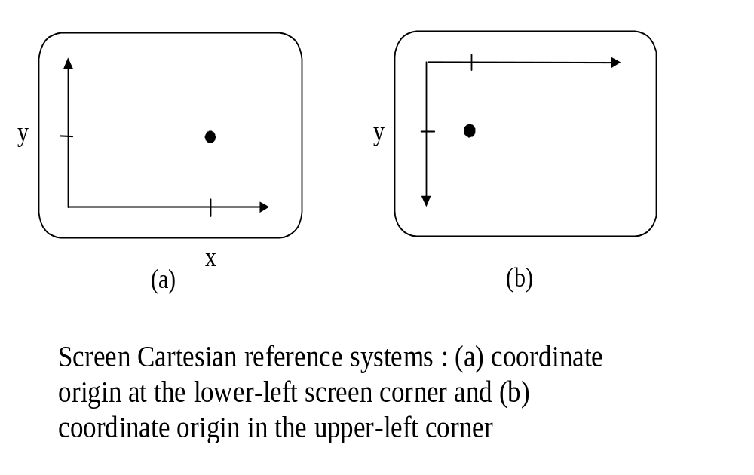
Coordinate Systems
(1) 2D Cartesian Reference Frames

Slide 4
(2) Polar Coordinates in the XY plane
A coordinate position is specified with a radial distance r from the coordinate origin, and an angular displacement θ from the horizontal.
Y
r
θ
X
A polar coordinate
reference
frame, formed
with concentric circles
and radial lines.

Slide 5
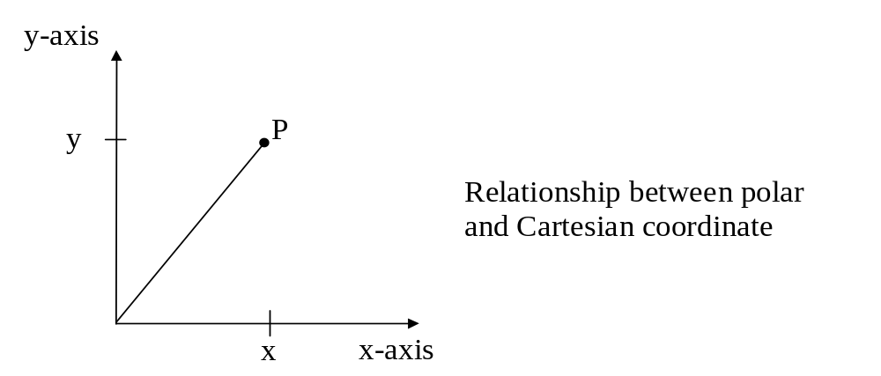
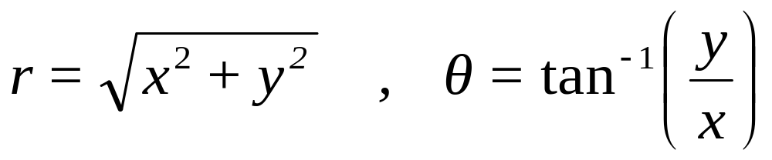
Relationship between Polar and Cartesian coordinates.
x = r cos θ , y = r sin θ
P = (x,y)
r
θ
0
The inverse transformation from Cartesian to Polar coordinates is:
Note: see atan2() in math.h
It maps (x,y) to (- π,+ π ]

Slide 6
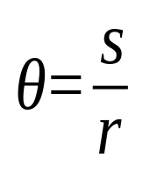
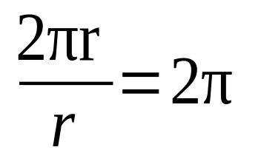
Definition of angle θ (in radian) :
s
θ
Definition:
P
r
An angle
θ
subtended by a
circular arc of length s and r.
Total angular distance around point P

Slide 7
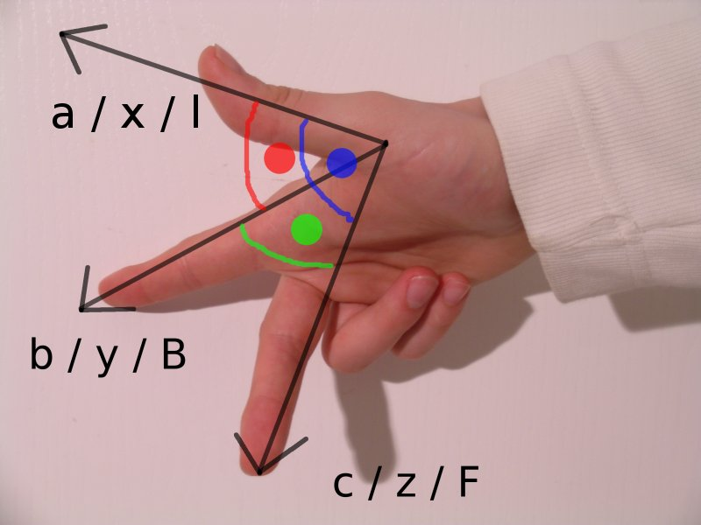
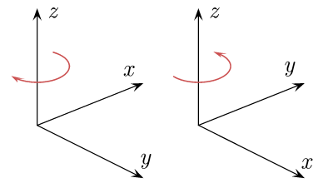
(3) 3D Cartesian Reference Frames
Left handed
Right handed
Notes:
GO over

Slide 8
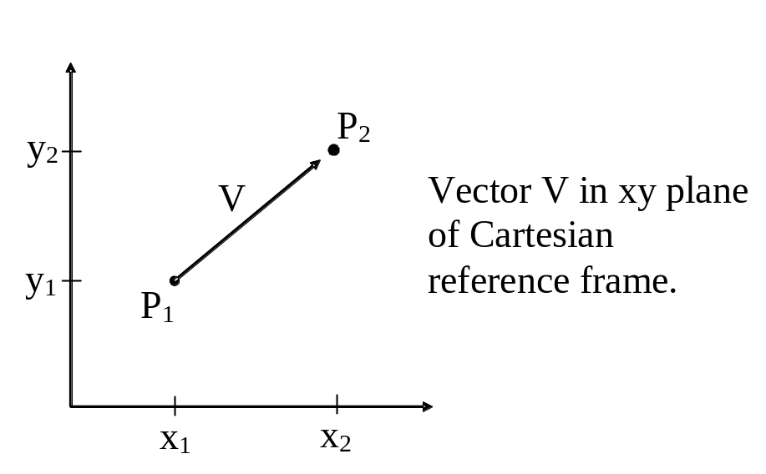
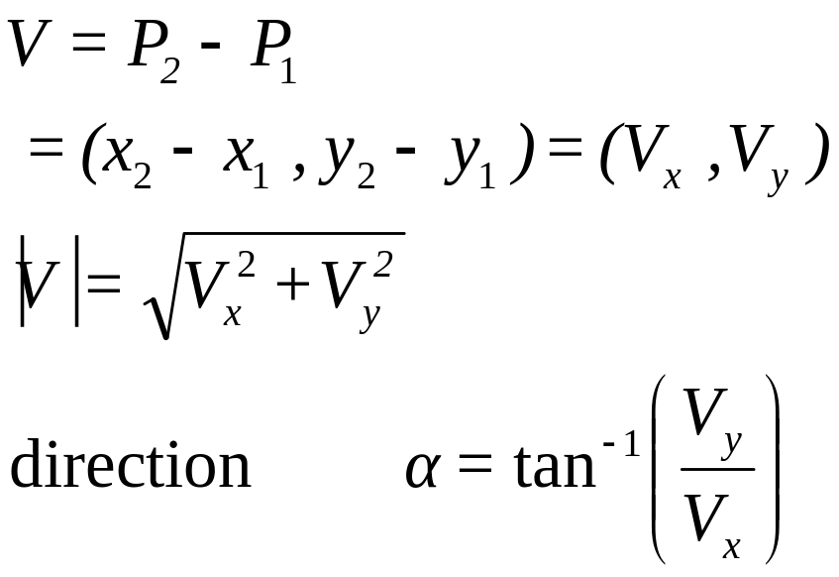
Points and Vectors
2D Vector
Change = “New – Old”
Note: see atan2() in math.h
It maps ( x , y ) to (- π,+ π ]

Slide 9
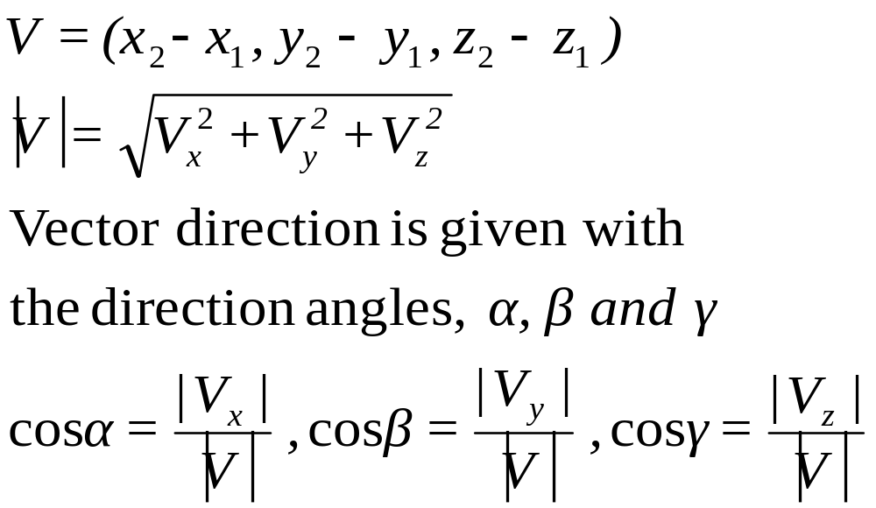
z
3D Vector
V
γ
β
α
y
x
Direction angles
α
,
β,
and
γ
.

Slide 10

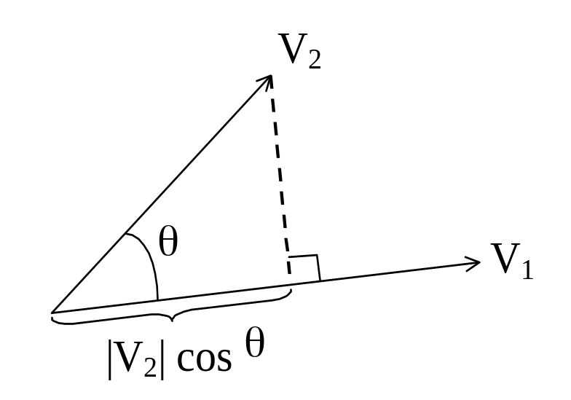
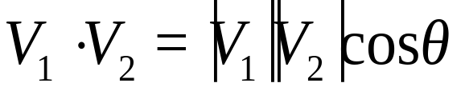
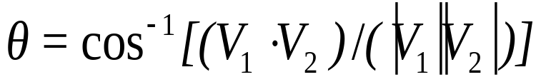
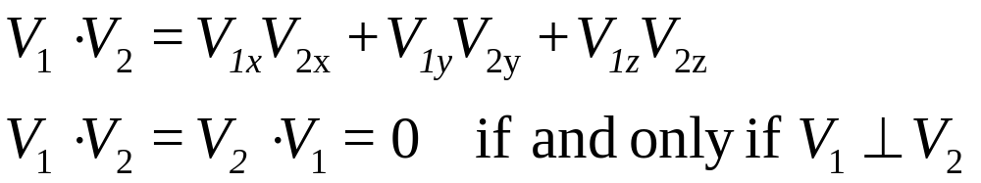
1. Vector Addition
2. Scalar Multiplication
3. Scalar Product ( Dot product )
where θ is the angle
between the two vectors

Slide 11
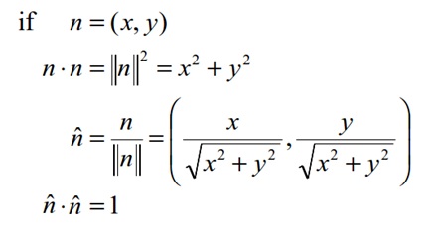
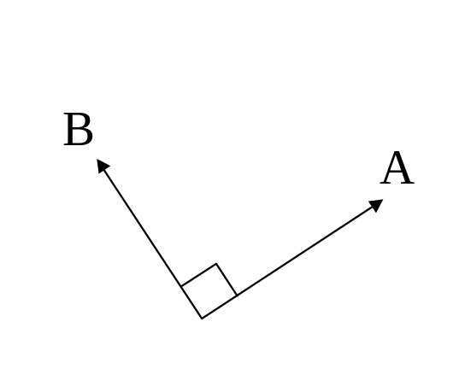
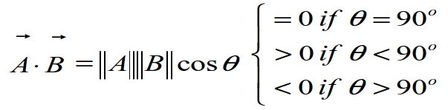
4. Normalization
  Keep same vector direction, but change magnitude to 1
5. Perpendicular

Slide 12
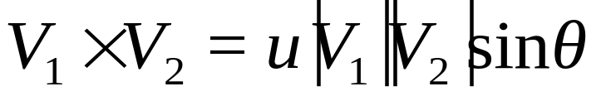
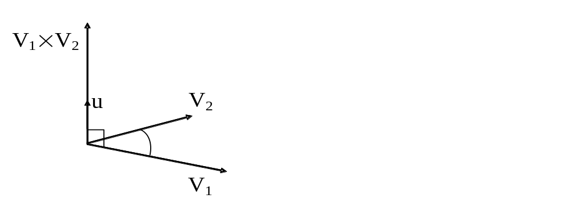
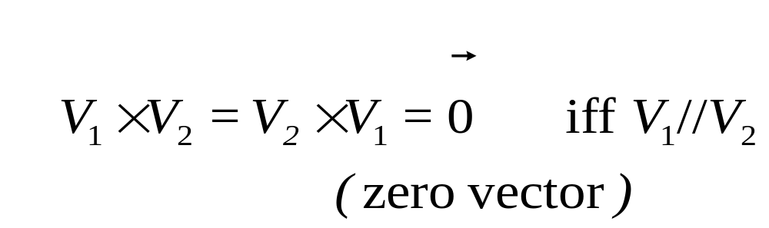
6. Cross Product of Two 3D Vectors
Multiplication of two vectors to produce another vector.
where u is the unit vector that is perpendicular to both V₁ and V₂

Slide 13
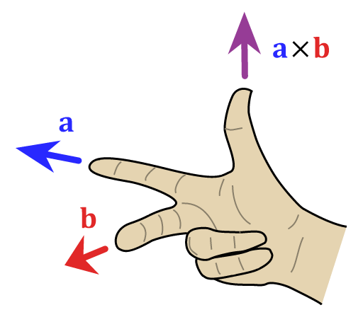
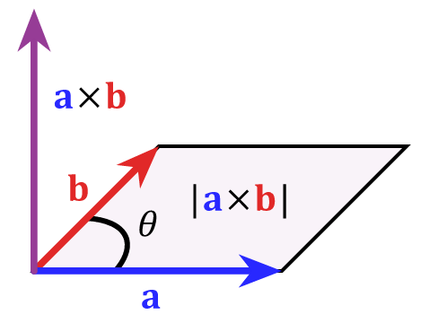

Slide 14
Useful 2D Mathematics for Computer Graphics
point and line
Proximity
  Point and Line
  Point and Line Segment
Line-Line Intersection
Which Side Test
Triangle or Polygon areas
Inside-Outside Test
point and line segment
d
d

Slide 15
Useful 2D Mathematics for Computer Graphics
P(x,y)
n
h
B(x2,y2)
A(x1,y1)
To find distance from P to Line AB
1. Find line direction
v = ( x2 - x1 , y2 - y1 ) = ( dx , dy )
2. Find normal of line by swapping elements in v
n = ( -dy , dx ) = ( y1 - y2 , x2 - x1 )

Slide 16
Useful 2D Mathematics for Computer Graphics
P(x,y)
h
B(x2,y2)
P-A
ˆ
n
A(x1,y1)
l
To find distance from P to Line AB
3. Normalize n and v as n and v
4. Use dot product to find h and l
h = | ( P - A ) . n | = | n . (x - x1 , y - y1) |
l = ( P - A ) . v = v . (x - x1 , y - y1)
ˆ
ˆ
ˆ
ˆ
ˆ
ˆ

Slide 17
Useful 2D Mathematics for Computer Graphics
P(x,y)
B(x2,y2)
A(x1,y1)
l
To find distance from P to Line Segment AB
1. Need to check l against length of AB
Note: l is signed.
2. If l < 0 or l > |AB|, compute point-point distance
(i.e. |AP| or |BP| )
3. Otherwise, compute point-line distance
(i.e. same as previous slide)

Slide 18
Useful 2D Mathematics for Computer Graphics
A(x1,y1)
D(x4,y4)
C(x3,y3)
B(x2,y2)
Line-Line Intersection
1. Express as parametric forms:
AB: ( x1 , y1 ) + t_{AB} ( x2-x1 , y2-y1 )
CD: ( x3 , y3 ) + t_{CD} ( x4-x3 , y4-y3 )
Note: varying t_{AB} and t_{CD} trace the whole line (same for 3D)

Slide 19
Useful 2D Mathematics for Computer Graphics
Line-Line Intersection
2. Two equations with Two unknowns (t_{AB} and t_{CD})
x1 + t_{AB} ( x2-x1 ) = x3 + t_{CD} ( x4-x3 )
y1 + t_{AB} ( y2-y1 ) = y3 + t_{CD} ( y4-y3 )
3. Solve this equation for t_{AB} or t_{CD}
Note: if no solution, AB and CD are parallel
4. Substitute back to the parametric form

Slide 20
Useful 2D Mathematics for Computer Graphics
Which-side Test: Given a point and a line
Compute cross product in 3D!
Use right hand rule.
Direction of z gives the answer.
v
b
a
a
a
“a X v” has different sign from “b X v”

Slide 21
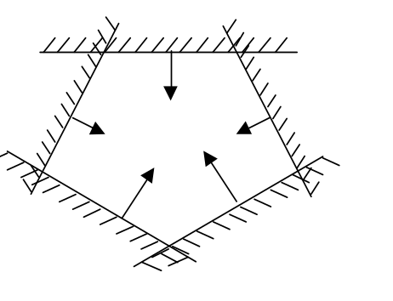
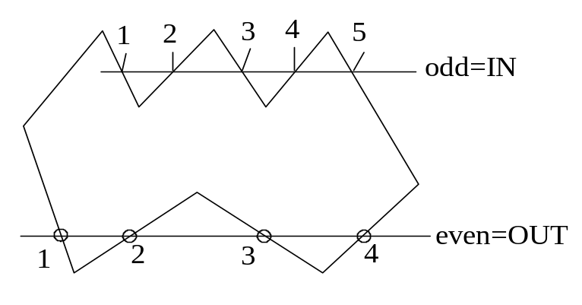
Useful 2D Mathematics for Computer Graphics
Inside-Outside Test
Method 1: Repeat the which-side test for each edge in order
Method 2: Odd-intersection Count
Note: this works for convex polygons only
number = 0 or even ⇒ outside
number = odd ⇒ inside

Slide 22
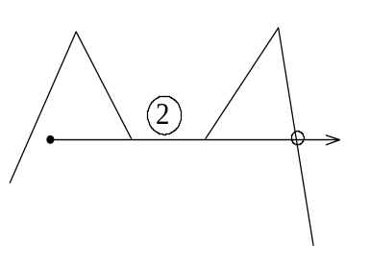
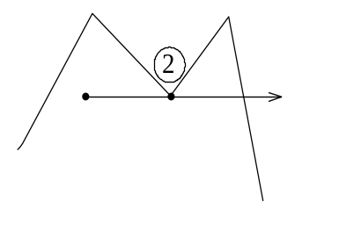
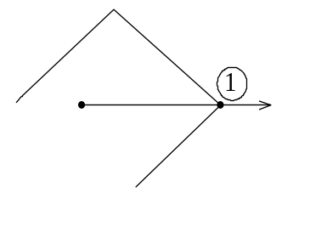
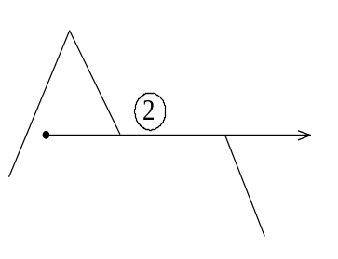
Useful 2D Mathematics for Computer Graphics
Inside-Outside Test
Weird cases in Odd-intersection Count
Direction change vertex must
count 0 or 2
Horizontal direction-change
line must count 0 or 2
No-direction-change
vertex must count 1
Horizontal no direction-change
line must count 1

Slide 23
Useful 3D Mathematics for Computer Graphics
Linear Interpolation (lerp)
Barycentric Coordinate
Spherical Linear Interpolation (slerp)
Face Normal and Vertex Normal

Slide 24
Useful 3D Mathematics for Computer Graphics
y
Linear Interpolation (lerp)
V
1
y
1
V
=
V
+
t
(
V
−
V
)
0
1
0
V
y
Vary t moves along line V₀ V₁
V
0
y
0
x
z
x
x
x
1
0

Slide 25
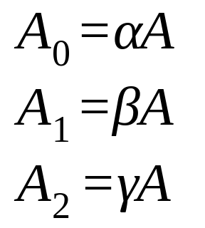
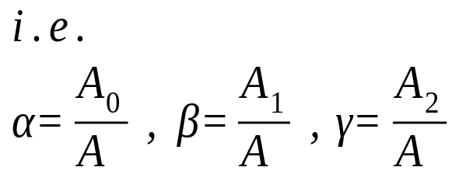
Useful 3D Mathematics for Computer Graphics
P
2
Barycentric Coordinate
- by means of area ratios
A₁
P
A₀
P
0
A₂
P
1
Note: varying α,β, and γ moves inside the triangle
useful for color mixing

Slide 26
Useful 3D Mathematics for Computer Graphics
Normal of a Triangle (Face Normal)
n
Given vertices V₀ , V₁ , and V₂
in anti-clockwise order
use right hand rule again!
V₂
V₀
front side
Normal n = ( V₁ - V₀ ) cross ( V₂ - V₀ )
V₁
Note: many ways to do this and this normal is assumed to the
front face normal (in OpenGL and many graphics API)

Slide 27
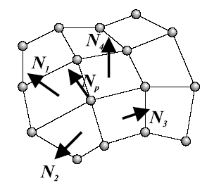
Useful 3D Mathematics for Computer Graphics
Approximate Normal at a Vertex (Vertex Normal)
Average the face normals of
neighboring faces

Slide 28
2D and 3D Transformations
What is a Transformation?
> Mapping points from one location to another
Basic Transformations:
  Identity (mapping every point to itself)
  Translation
  Scaling
  Rotation
  Shearing
  Reflection

Slide 29
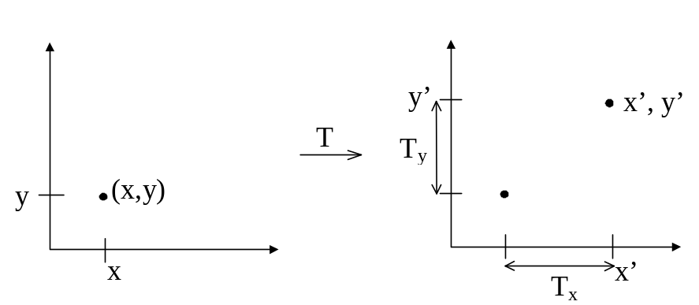
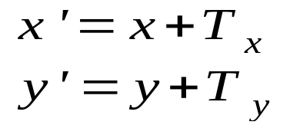
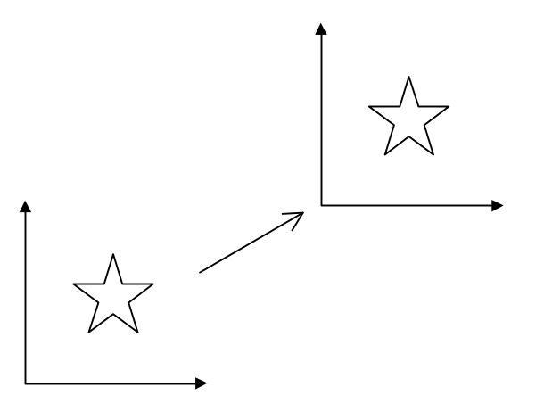
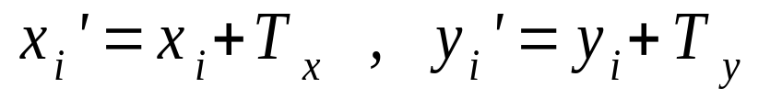
2D Translation
Move points of an object to a new place
Many Points { (x_{i} , y_{i}) } by adding same constant

Slide 30
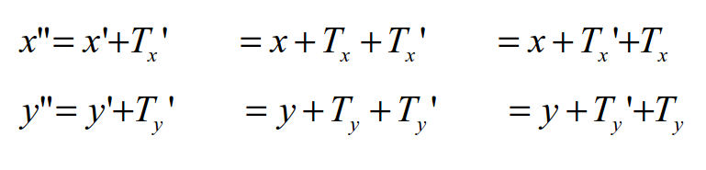
Properties
1. No Fixed points under translation.
- all points move
2. Multiple translations are order-independent

Slide 31
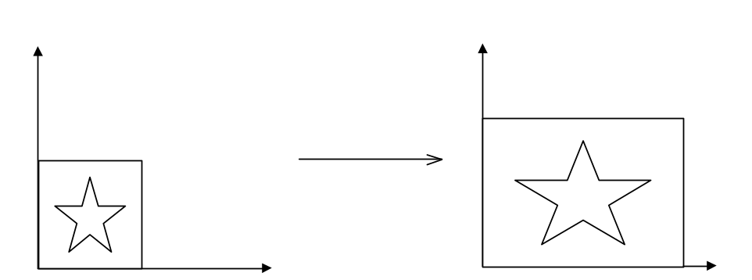
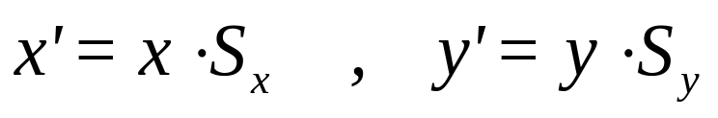
2D Scaling
Changes the size of an object
Properties :
Origin fixed : x’ = 0 if x = 0 ( fixed point is origin )
Order independent : x” = x’• S_{x}’ = x • S_{x} • S_{x}’ = x • S_{x}’ • S_{x}

Slide 32
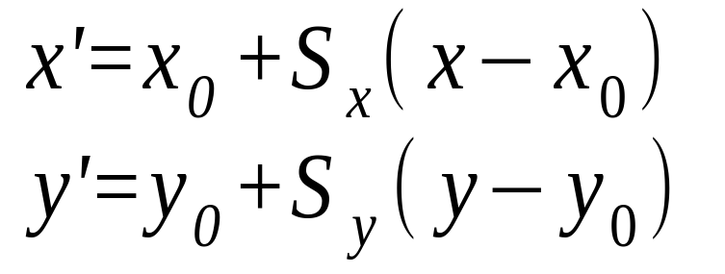
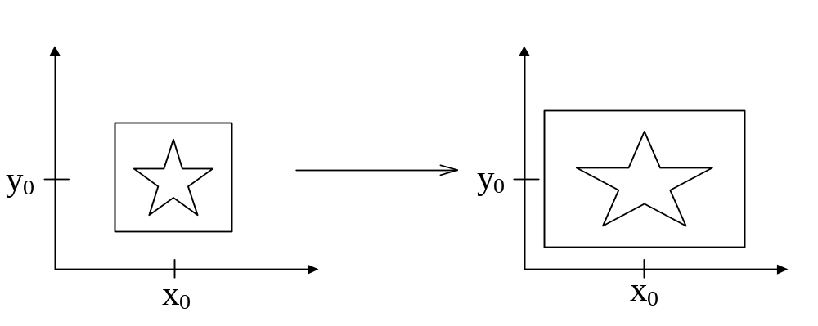
Single out arbitrary Fixed point scaling at (x₀,y₀) as follows :

Slide 33
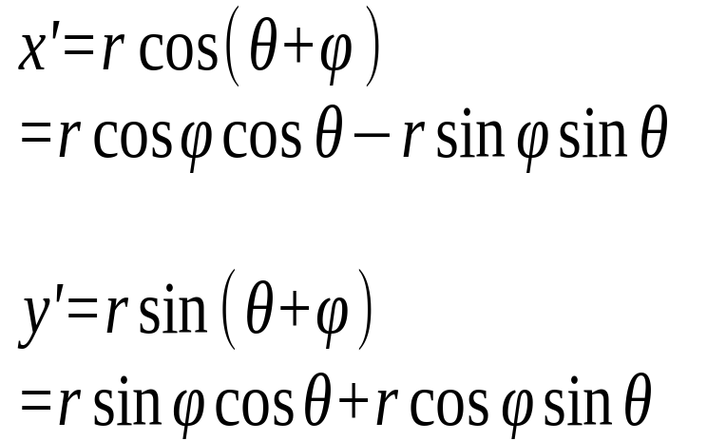
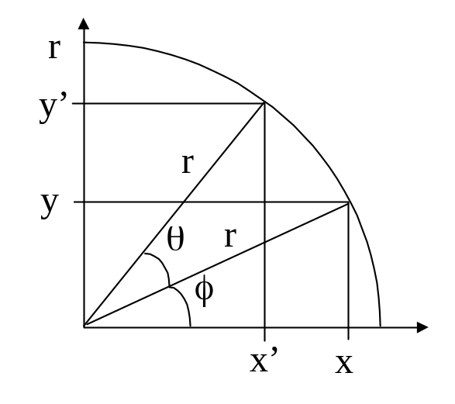
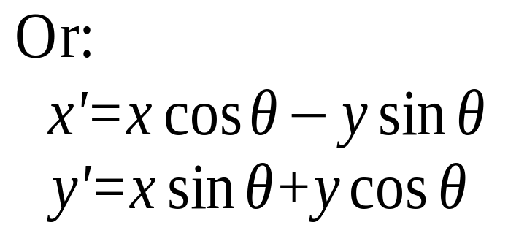
2D Rotation
Rotate by θ (always anti-clockwise in CG) :
From (x, y) to (x', y'):
(by angle addition formula)
x = r cos φ
y = r sin φ
Note: r is fixed during rotation. Also,
If r = 0, (x, y) = (0, 0) for any φ

Slide 34
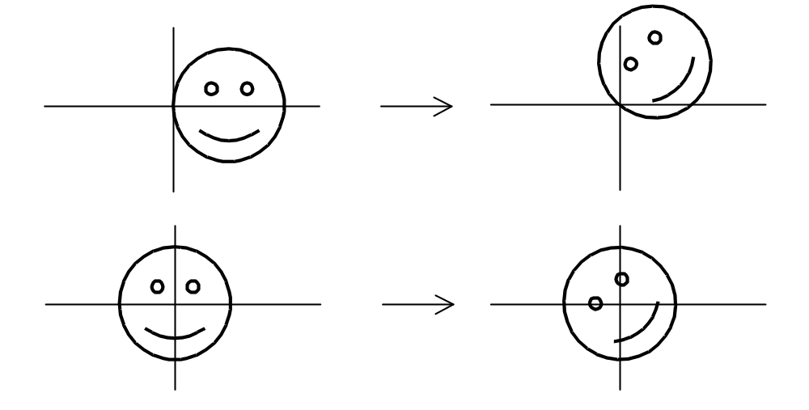
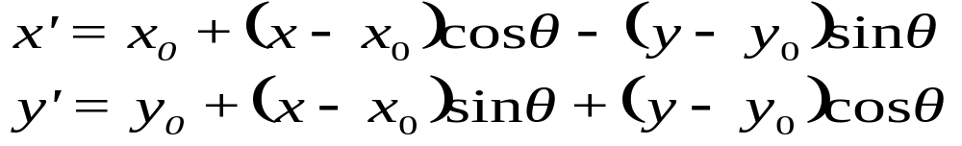
Fixed point: Origin dependent
but
General rotation about Fixed point ( x₀ , y₀ )

Slide 35
Other 2D Transformations
Reflection (about X/Y-axis)
y
y
x
x’=-x , y’=y
OR
y
y
x
x’=x , y’=-y
Note: about arbitrary axis is possible

Slide 36
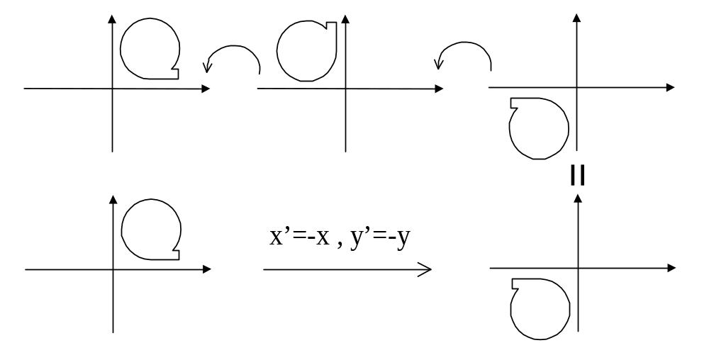
Reflection about X or Y is NOT equivalent to a rotation
But reflect about both x & y , i.e. x’ = - x, y’ = -y, is a rotation.
Note: reflection can be treated as a scaling with -1
(just a matter of how you see the terms)

Slide 37
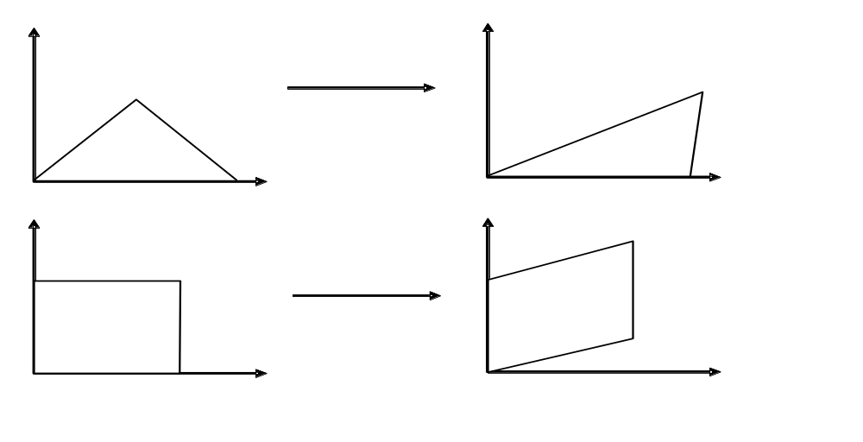
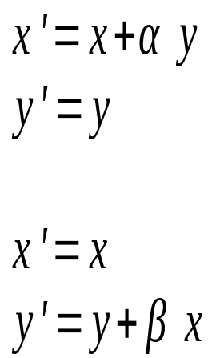
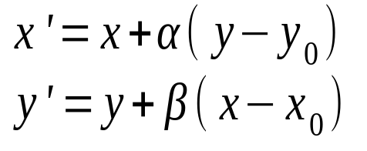
2D Shearing
Along x
Along y
So we see Fixed point at the origin
General fixed point at ( x₀ , y₀ ) :

Slide 38

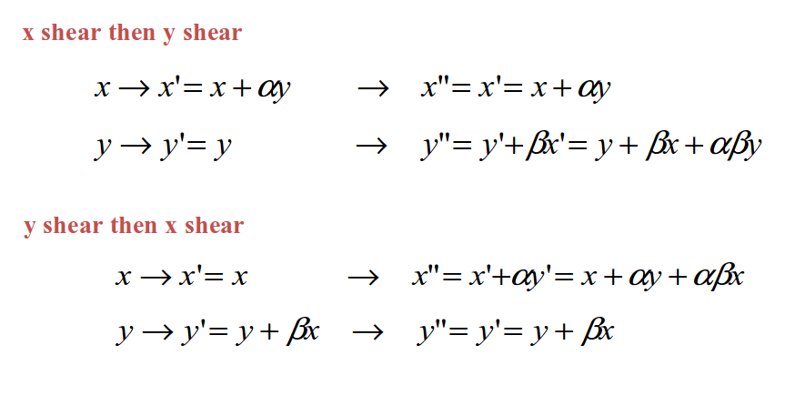


Multiple Shearing is order dependent !!
Different!

Slide 39


Using Matrix Representation for Transformations
We need to use homogeneous coordinates to loft
2-space to 3-space by adding one more component
such that
2D coordinate
Note:
1. r = 0 implies points at infinity
  (remember)
2. r is usually “one” for our case
2D homogeneous coordinate

Slide 40




Homogeneous Representations
Revisit 2D Translation (2 parameters) – needs homogeneous coords
Inverse:
Revisit 2D Scaling (2 parameters)
Inverse:
Reflection can be treated as S_{x}/S_{y} = +1/-1

Slide 41








Note:
Homogeneous Representations
Revisit 2D Rotation (1 parameter)
Inverse:
Revisit 2D Shearing (2 parameters)
Along X
Inverse:
Along Y
Inverse:
Notes:
Get inverse or delete

Slide 42

General Treatment of Origin Dependence (3 steps)
1) Pre-transform P to reference position / orientation

Slide 43

2) Do transform T (e.g. reflect in y)

Slide 44

3) invert the pre-transform P⁻¹ ( post transform)

Slide 45

Derive : Fixed Point Rule for Scale/Rotate/Shear
Using:
1. Translate Fixed point x to origin
2. Scale, Rotate, Shear,
3. Translate origin back to fixed point

Slide 46


All the above transformations are Affine Transformations
Definition: Transformations that preserve parallelism
such that we have the following properties:
Lines are still lines
Parallel lines remain parallel
Midpoints map to midpoint (ratios are always preserved)
But angle/length not preserved
General form:
e.g. a shear:

Slide 47


How about 3D Transformations
Use 4 x 4 matrices for 3D transformations.
Use homogeneous coordinate representation
represents (x,y,z) as (x,y,z,w)
a standard representation of a point (x,y,z,w) with w≠0 is given by
3D right-handed coordinate system
(again, w=0 means a position
at infinity, remember)

Slide 48


3D Translations (3 parameters)
3D Scaling (3 parameters)
Try to do the matrix multiplication on a piece of paper

Slide 49



Rotation about X-axis
(1 parameters)
Rotation about Y-axis
(1 parameters)
Rotation about Z-axis
(1 parameters)
Note: left-multiplication of vector/point

Slide 50


Axis-angle Representation (Arbitrary Rotation, 4 parameters)
  Unit vector for the axis of rotation n = ( n_{x} , n_{y} , n_{z} )
  Rotation angle θ
where c = cosθ and s = sinθ
http://en.wikipedia.org/wiki/Axis-angle_representation

Slide 51




A very useful method to know: Rotation as Frames
  Given three orthogonal unit vectors u , v , and w
  If you want to rotate the coordinates such that
    x-axis becomes u
    y-axis becomes v
    z-axis becomes w
  - You can construct a rotation matrix:
  - Check:

Slide 52


General Transformation Rule (TRS) with Fixed-Point for S/R
Orders of
Operations
3. Translate
2. Rotate
1. scale
Note: always stick to left-multiplication

Slide 53

Preview: Mapping this to OpenGL is like:
glTranslatef ( tx , ty , tz ) ;
glTranslatef (xR , yR, zR ) ;
glRotatef ( theta , xdir, ydir, zdir ) ;
glTranslatef ( -xR , -yR, -zR ) ;
glTranslatef (xF , yF, zF ) ;
glScalef ( Sx , Sy , Sz ) ;
glTranslatef ( -xF , -yF, -zF ) ;
drawObj();
Orders of
matrix Multiplications
on vertices in drawObj()

